Slide 1
Feasibility Report

Slide 2
What is a feasibility study?
An analysis of the viability of an idea through disciplined documented process of thinking
Primarily the most important thing before developing a project

Slide 3
Reasons to do a feasibility study
Gives focus to the project
Narrows the business alternatives
Identifies the new opportunities
Identfies reasons not to proceed
Provides documentation that the idea is thouroughly investigated

Slide 4
TYPES OF FEASIBILITY

Slide 5
1. Operational Feasibility
Useful to identify the operational problems to be solved
PIECES framework
Performance
Information
Economy
Control
Efficiency
Services

Slide 6
2. Market feasibility
Determine facility needs
Suitability of production technology
Availability of site
Raw material

Slide 7
3. Economic Feasibility
Estimate the total capital requirement
Budget, expected costs and needs

Slide 8
4. Legal Feasibility
Legal requirements to be carried out for the proposed project

Slide 9
FEASIBILITY REPORT CONTENT
Introduction/ executive summary
Background
Outline of the project
Methodology for analysis
Overview of other alternatives
Conclusion
Recommendation

Slide 10
1.Introduction/Executive summary
States the objective of the report and the project
Should refer the terms for reference
Should state the constraints within which it has been conducted

Slide 11
2. Background
Some reports may require some background discussion in order to make the report meaningful to the readers
Describe your proposed plan in sufficient detail
You may need to discuss the problem, need,or opportunity that has brought about this report

Slide 12
3.Outline of the system
Involves description of project
List type and quality of prodcuts or services to be marketed
Outline business model (how the business will make money)
Include the technical processes, size, location and other inputs
Specify the time horizon

Slide 13
4. Methodology
It involves discussion on methods of anlysis for feasibility study.
For example
Return of Investment (ROI) analysis
“Return on Investment (ROI) is a performance measure used to evaluate the efficiency of an investment or compare the efficiency of a number of different investments. ROI tries to directly measure the amount of return on a particular investment, relative to the investment’s cost”
​ROI=Cost of Investment -- Current Value of Investment /Cost of Investment​​

Slide 14


Slide 15
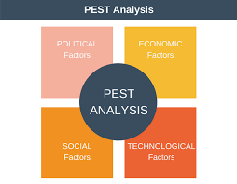

Slide 16
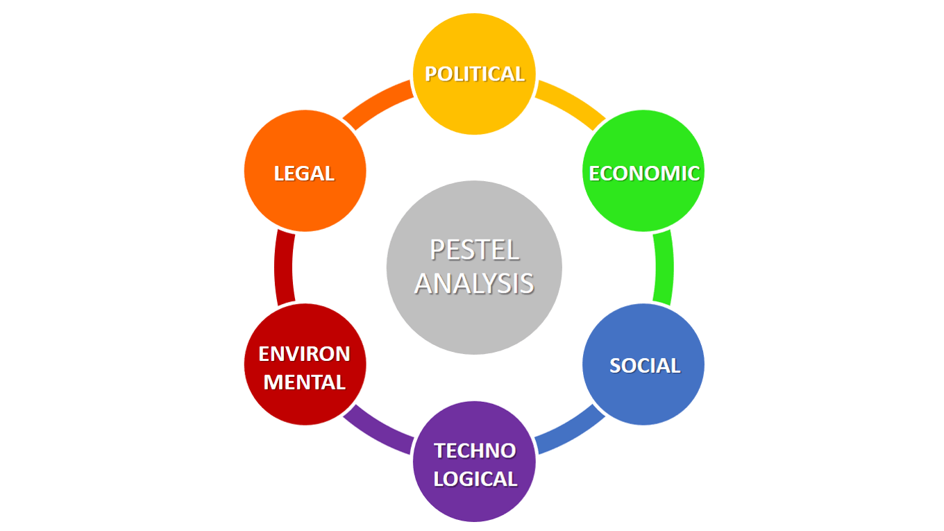

Slide 17
5. Overview of alternatives
Possible alternatives
Advantages and disadvantages of alternatives
Note:
This section can be presented in the form of tables and charts

Slide 18
Estimate equity and credit needs (For alternatives)
Identify alternative equity sources and availability
Identify and assess alternative credit sources
Assess expected financial needs

Slide 19
ii. Costs and benefit evaluation
It demonstrate how the proposal is feasible
Involves discussion on technological, economical, social and ecological soundness
Cost includes development, purchasing, installation and operational

Slide 20
6. Conclusion
This section includes the restatement of conclusions that you have already reached in the comparison sections.
You restate the individual section as well as to what extent your proposal is feasible
It should entangle all the conflicting conclusions and present one concrete conclusion which you think is the best.

